Slide 1

Case study: Direct Marketing OptimiSation Andy Ang

Slide 2

AGENDA
Modeling approach
Model evaluation
Profiles with high propensity
Additional Comments on assignment
Answers to submission requirements
appendix

Slide 3
Modeling Approach
1
Pre-Processing
2
Model Building
3
Target Optimisation
soc_dem
Assume this is base dataset that contains all customer
One hot encoding for ‘Sex’
Train (70%)
Test (30%)
Revenue Calculation: Calculate average revenue per customer per product from sales_rev.
Expected Revenue Formula: Expected Revenue per Customer per Product = Model Probability * Average Revenue per Customer per Product
Product Recommendation: For each customer, recommend the product with the highest expected revenue.
Output Fields:
Probabilities: Prob_MF, Prob_CC, Prob_CL
Expected Revenue: Exp_Rev_MF, Exp_Rev_CC, Exp_Rev_CL
Product Recommendation: rec_prod
Imbalanced Dataset: The dataset has an imbalance in target classes.
Train/Test Split: Use stratification on all three target classes during the split to ensure the test data includes sufficient positive samples.
Use calibrated model to predict probabilities on the test set.
pdt_acct_bal
join other datasets with client ID
inflow_outflow
Hyperparameter Tuning
sales_rev
Used RandomizedSearchCV.
Alternative Methods: Bayesian Optimization and GridSearchCV.
Target Field: Use Sale_ fields as the target variable
Input Restriction: Exclude Revenue_ fields as inputs to prevent data leakage.
Train Model / Calibrate Model
Model Training: Train an XGBoost model for each product using the best parameters.
Probability Calibration: Calibrate output probabilities to better reflect actual likelihood, enabling comparison across models.

Slide 4
Model evaluation
Objective: Compare model performance by evaluating precision on the top 15% of the test dataset against a random baseline.
Random Baseline: Estimates how many customers would purchase a specific product if targeted randomly. # of customers with sale / total # of customers
Product | Random Baseline | Precision of Top 15% for each model | Lift
Mutual Fund | 193/1,615 = 0.1195 | 12/73 = 0.1644 | 0.1644 / 0.1195 = 1.38x
Credit Card | 242/1,615 = 0.1498 | 12/73 = 0.1644 | 0.1644 / 0.1498 = 1.10x
Consumer Loan | 290/1,615 = 0.1796 | 8/73 = 0.1096 | 0.1096 / 0.1796 = 0.61x
This may not be the ideal way to evaluate the model, but it seems to be the only feasible approach given the data available.
Consumer Loan model shows worse precision compared to the random baseline. Possible improvements include adding more data or reducing the target percentile from 15% to 10%.

Slide 5
Profiles with higher propensity
Approach: I used SHAP plots to analyse how each feature impacts the model's predictions, then leveraged the top features to create a customer profile. (The plots can be seen in the appendix)
Mutual Fund | Credit Card | Consumer Loan
Age between 30 and 60 TransactionsDebCashless_Card > 12 VolumeCred_CA > 2000 ActBal_CA < 5000 Tenure between 50 and 80 TransactionsDeb < 5 | ActBal_CA > 8000 VolumeDeb_PaymentOrder < 1000 Age between 30 and 40, Age between 50 and 65 VolumeCred > 3000 VolumeDebCash_Card > 800 VolumeDeb > 4000 | Age < 30 VolumeCred_CA < 2000 Tenure > 150 ActBal_CA < 5000 TransactionsDeb_CA > 10 VolumeDeb_CA > 2000
Keep in mind that highly predictive features may not always be meaningful. Sometimes, their significance could be coincidental.
Collaborating with the business team is essential to gain deeper insights.
Occasionally, we might surprise the business by identifying new features that haven't been explored before.

Slide 6
Additional Comments on assignment
Model Selection: If targeting each customer with only one product, a multiclass model may be more effective than separate models. This is because scores across different models are not directly comparable (e.g., 0.9 in Model A ≠ 0.6 in Model B). To address this, probabilities in this example were calibrated for comparability.
Target Optimisation: Optimising solely for revenue may not align with long-term goals. Different products have unique customer value propositions. Some products drive customer engagement over time, leading to increased transactions, savings, or investments. Therefore, focusing on short-term revenue might not be ideal. In addition, for more complex products, human intervention is often required to assess eligibility and suitability. Instead of recommending a single product, providing a list indicating high/low propensity for each product may offer better insights and flexibility.

Slide 7
Submission Requirements
Test Dataset Prediction Output: test_recommendation.csv
Which clients have a higher propensity to buy a consumer loan/credit card/mutual fund?
Prob_MF, Prob_CC, Prob_CL fields contains the propensity scores for each product
Which clients are to be targeted with which offer?
rec_prod field contains the recommended product for each customer based on highest expected revenue across the 3 products
What would be the expected revenue based on your strategy?
For top 15%, expected revenue for $10.52 for each customer

Slide 8
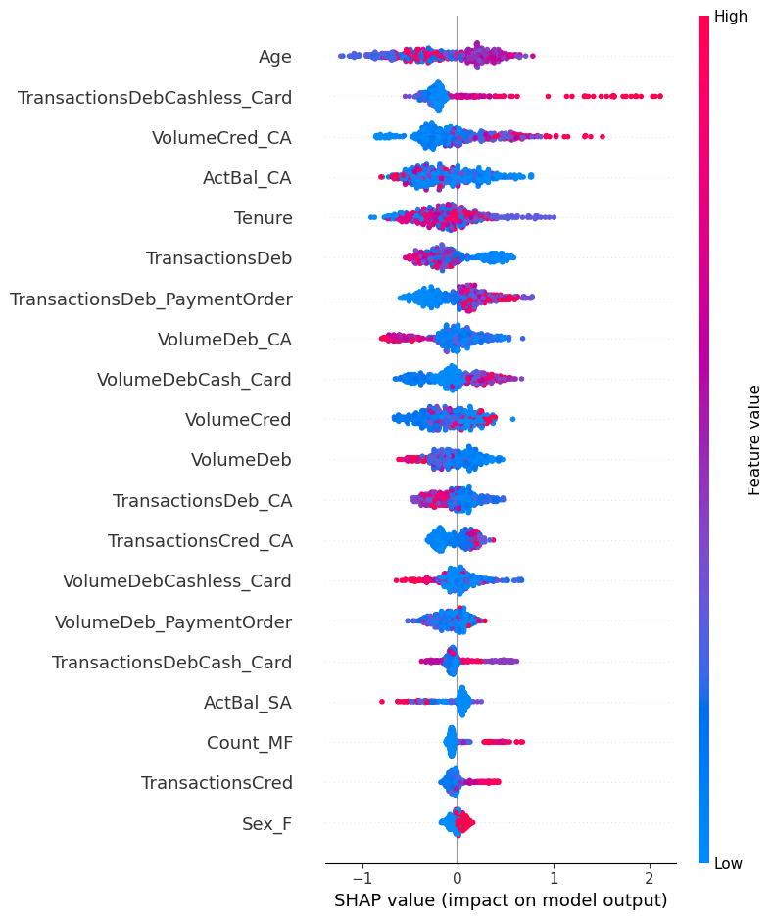
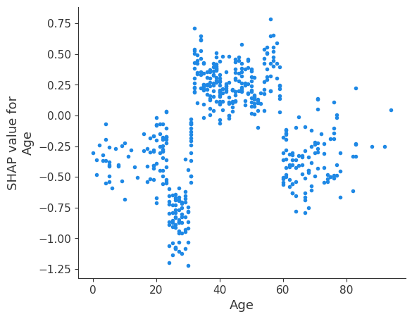
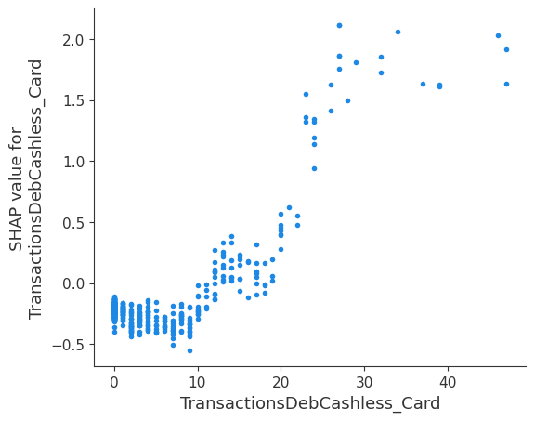
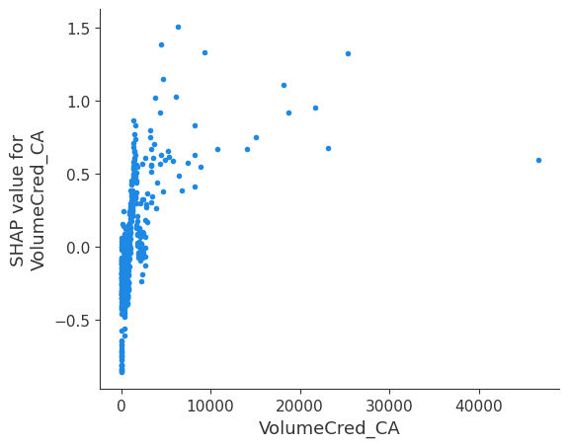
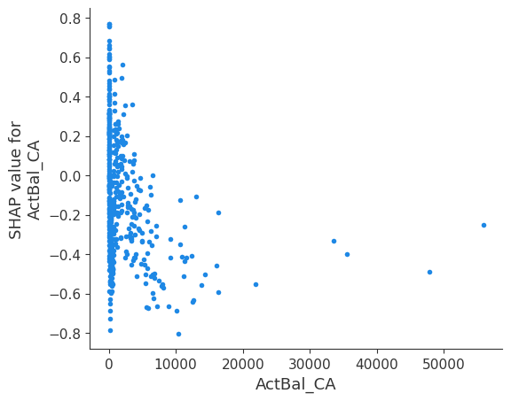
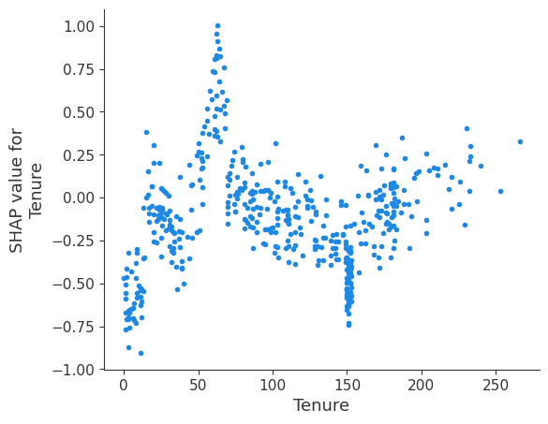
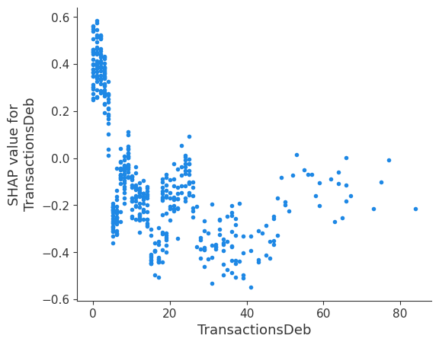
Appendix: MF Shap plots

Slide 9
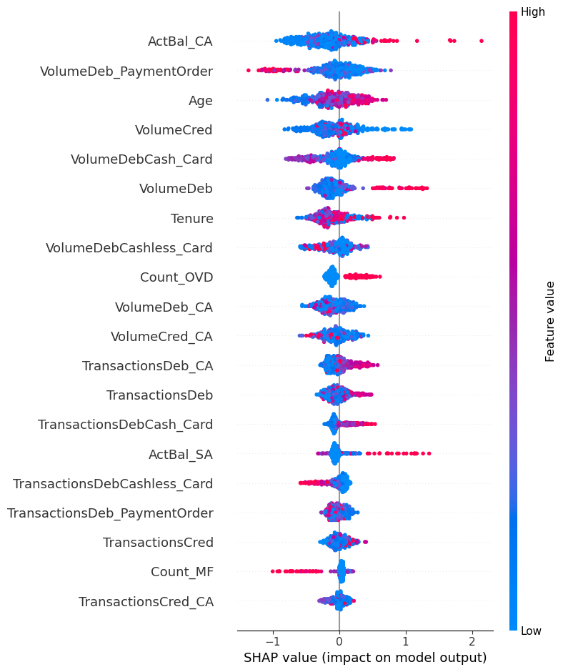
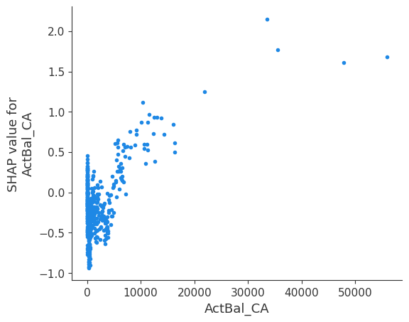
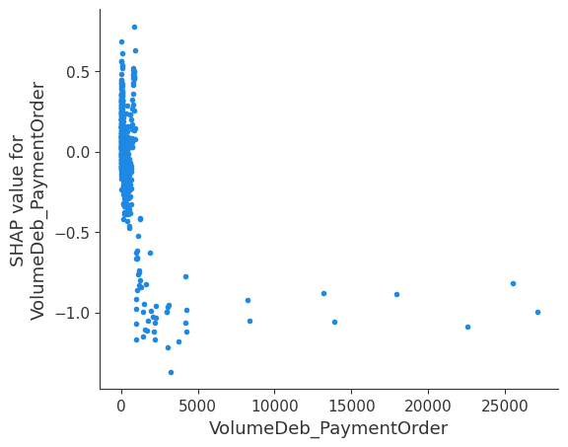
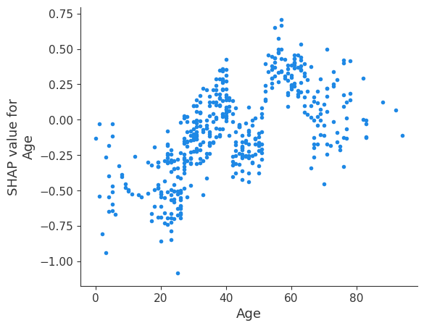
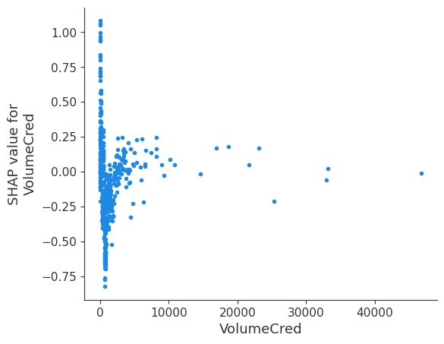
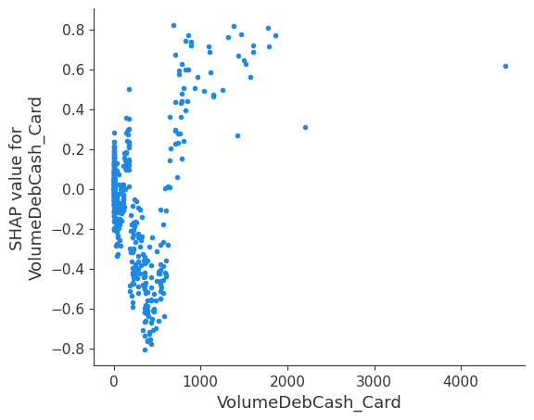
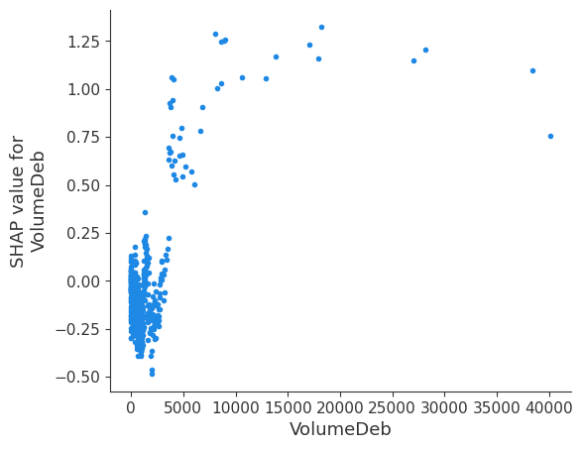
Appendix: CC Shap plots

Slide 10
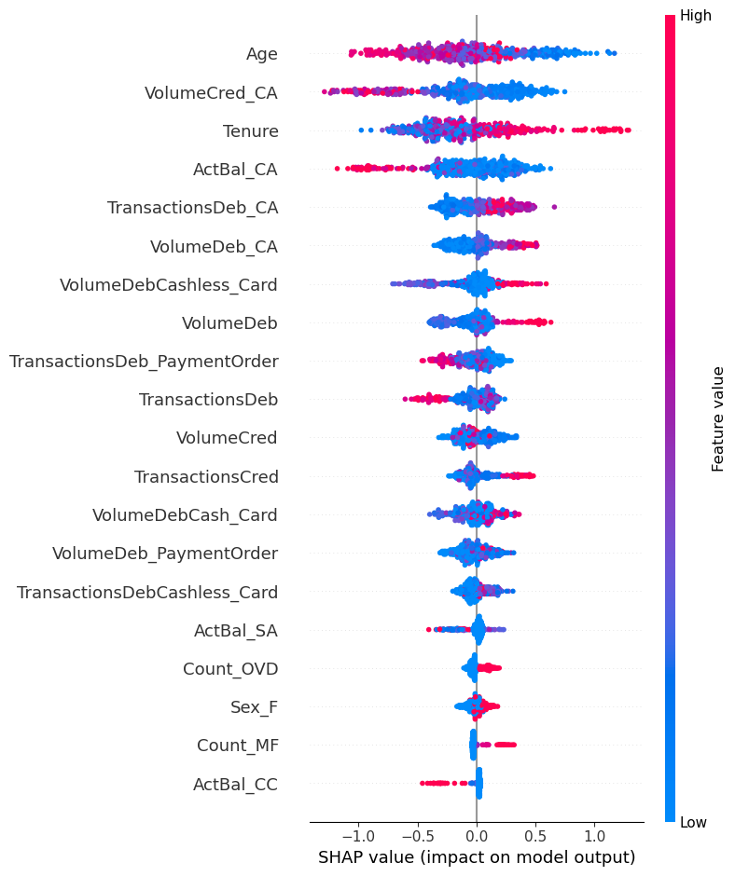
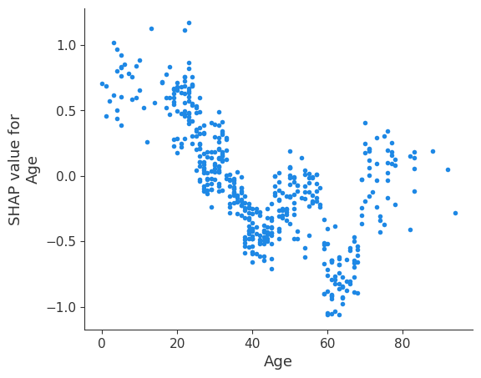
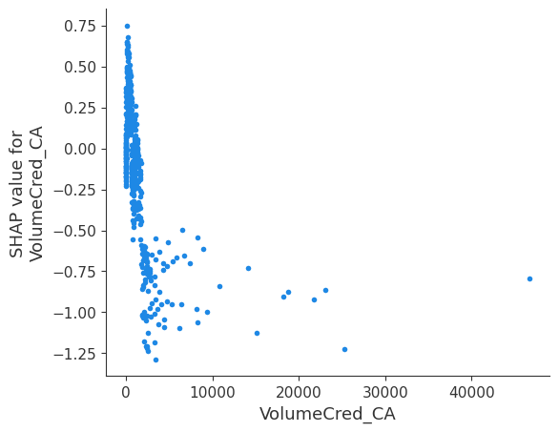
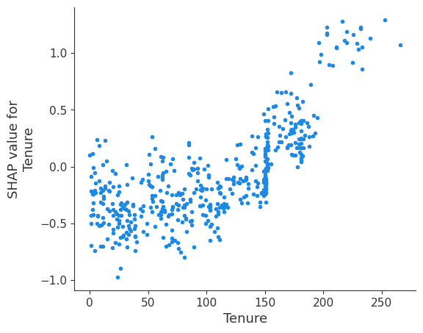
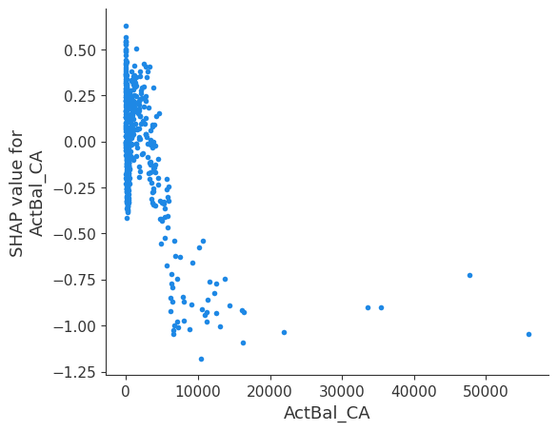
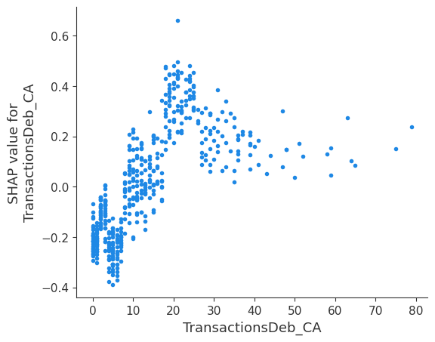
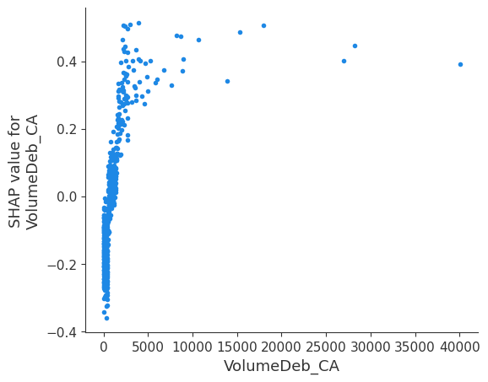
Appendix: CL Shap plots

